Slide 1

Rechnerarchitekturen für Deep-Learning Anwendungen (RADL)
Dustin Heither, Maximilian Achenbach, and Robert Kagan
Optimizing Deep Learning Performance:
A Hybrid CPU-GPU Framework with Multithreading, SIMD,
and Evaluation of Efficiency Metrics

Slide 2
Outline
5. Presentation
01
Tweaks & Enhancements
02
Hardware & Benchmark
03
CUDA Tuning
04
Multithreading & SIMD
05
Quantization
06
Outlook

Slide 3
Tweaks & Enhancements
Overview
Build System Enhancements:
Goal: Support new compiler flags
Solution: Updated make config
Data Preprocessing:
Goal: Avoid repeated transposing
Solution: Pre-transposed fc_bias and fc_weights
Function Inlining:
Goal: Minimize overhead caused by function calls
Solution: Inlined all remaining functions
Optimization Flags:
Goal: Enable optimizations and detect memory issues
Solution: Integrated -O3 and -fsanitize=address
AVX-512 Optimization:
Goal: Avoid repeated inline assembly runtime checks for AVX-512
Solution: Relocated the checks for AVX-512 to the Makefile

Slide 4
Hardware & Benchmark
Hardware
CPU | Release date | TDP (W) | Number of (performance) cores | Number of threads
AMD Ryzen 7 3800XT | 7. Juli 2020 | 105 | 8 | 16
Apple M3 Pro 11-Core | 30. Oktober 2023 | 27 | 5 | 11
Intel Core i7 1065G7 | 1. Juni 2019 | 15 | 4 | 8
GPU | Release date | TDP (W) | Number of CUDA cores | Base Clock (MHz)
NVIDIA GeForce RTX 2080 | 20. September 2018 | 215 | 2944 | 1515
NVIDIA GeForce MX350 | 10. February 2020 | 20 | 640 | 1354

Slide 5
Hardware & Benchmark
Benchmark
Batch size: 1
Epochs: 128
Unit:
Total time
In microseconds (µs)
⚠️ Averaged over 12 runs
⚠️ Discarding first 2 runs
Lower is better
Old:
Last presentation
Quantization:
Data type: int8
XL:
Image dimensions: (32x30)²

Slide 6
CUDA Tuning
Overview
Fixed CUDA Transpose:
Change: Corrected the previously incorrect implementation
Benefit: Ensured accurate functionality and improved code reliability
Implemented CUDA Constant Memory for Conv2D:
Change: Optimized kernel operations using constant memory for frequently accessed data
Benefit: Reduced memory latency and improved execution speed
Implemented CUDA Pipeline:
Change: Introduced efficient pipelining mechanisms for overlapping data transfer and computation
Benefit: Enhanced GPU utilization and throughput
Separated GPU Allocations from CPU:
Change: Decoupled memory management between CPU and GPU
Benefit: Improved resource management

Slide 7
CUDA Tuning
Profiling with nvprof
Key Takeaways
MNIST:
34% matmul
18% conv2d
12% maxpool, biasing, relu
XL:
94% matmul
<2% other functions
Key Insights
matmul becomes the bottleneck in XL
Explanation
matmul complexity: O(n³)
Other functions: O(n²)
Scale factor: 32
Growth Factor:
matmul: 32,768
Other functions: 1024
Goal
Improve matmul computation speed

Slide 8
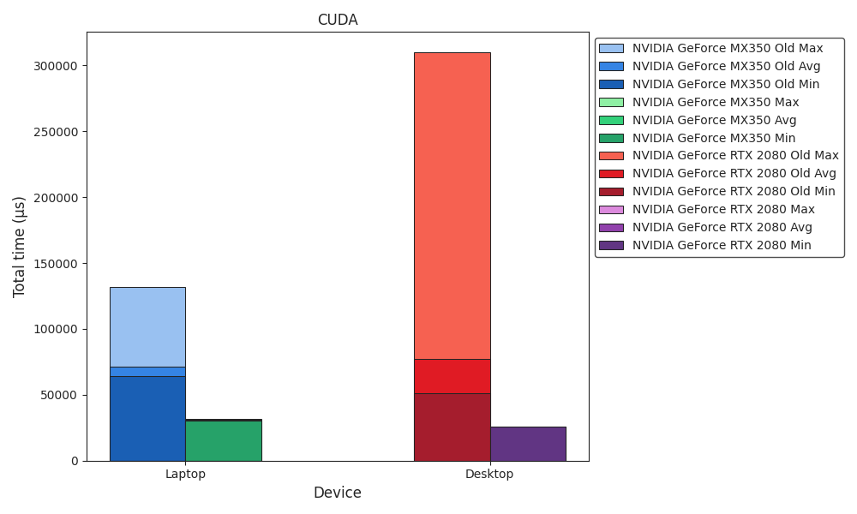
Benchmark
CUDA

Slide 9
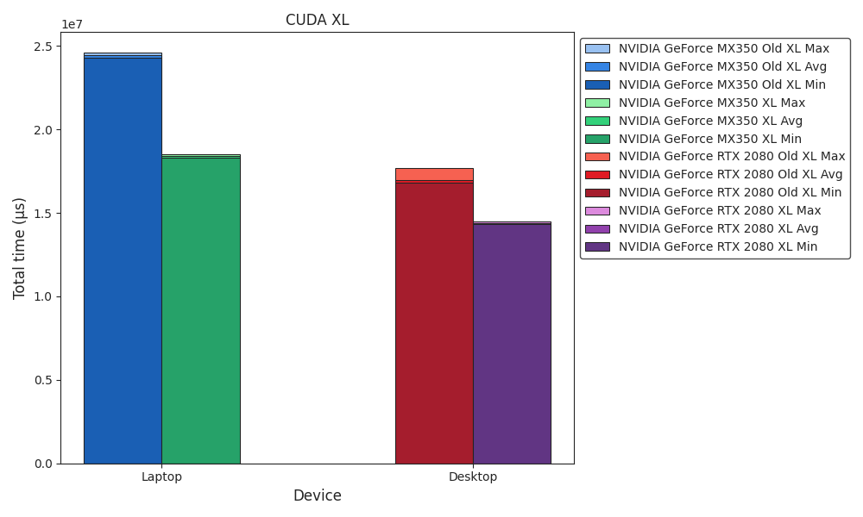
Benchmark
CUDA XL

Slide 10
Multithreading & SIMD
Multithreading
Fixed Memory Leak
Change: Resolved a memory leak that had existed for a long time
Benefit: Reduced memory usage
Enhanced Poison Pill
Change: Removed costly if comparisons
Benefit: Direct thread termination
Optimized mt_arg
Change:
Reduced the size of mt_arg
Moved mt_arg to its own header file
Benefit: Lower memory overhead and improved modularity
Enhanced Multithreading
Change: Improved smart multithreading and thread distribution
Benefit: Better performance and workload balance
Before:
void create_mt(long threads) {
...
mt_arg *mt = (mt_arg*)malloc(THREADS * sizeof(mt_arg));
for(long i = 0; i < THREADS; i++) {
mt[i].idx = i;
pthread_create(&tids[i], NULL, start_mt, &mt[i]);
}
}
static void *start_mt(void *arg) {
mt_arg *mt = (mt_arg*)arg;
while(1) {
mt_arg *head = (mt_arg*)g_async_queue_pop(queue);
if(head->start_routine == stop_mt) {
break;
}
head->idx = mt->idx;
head->start_routine(head);
}
return NULL;
}

Slide 11
Multithreading & SIMD
Multithreading
Fixed Memory Leak
Change: Resolved a memory leak that had existed for a long time
Benefit: Reduced memory usage
Enhanced Poison Pill
Change: Removed costly if comparisons
Benefit: Direct thread termination
Optimized mt_arg
Change:
Reduced the size of mt_arg
Moved mt_arg to its own header file
Benefit: Lower memory overhead and improved modularity
Enhanced Multithreading
Change: Improved smart multithreading and thread distribution
Benefit: Better performance and workload balance
After:
__attribute__((always_inline)) inline void create_mt(int threads) {
...
int idx[THREADS];
for(int i = 0; i < THREADS; i++) {
idx[i] = i;
pthread_create(&tids[i], NULL, start_mt, &idx[i]);
}
wait_mt();
}
__attribute__((always_inline)) inline static void *start_mt(void *arg) {
int idx = *(int*)arg;
wait_mt();
while(1) {
mt_arg *head = (mt_arg*)g_async_queue_pop(queue);
head->idx = idx;
head->start_routine(head);
}
return NULL;
}

Slide 12
Multithreading & SIMD
Multithreading
Fixed Memory Leak
Change: Resolved a memory leak that had existed for a long time
Benefit: Reduced memory usage
Enhanced Poison Pill
Change: Removed costly if comparisons
Benefit: Direct thread termination
Optimized mt_arg
Change:
Reduced the size of mt_arg
Moved mt_arg to its own header file
Benefit: Lower memory overhead and improved modularity
Enhanced Multithreading
Change: Improved smart multithreading and thread distribution
Benefit: Better performance and workload balance
Before (mt.hpp):
typedef struct mt_arg {
long idx;
matrix **a_ptr;
matrix *a;
matrix **b_ptr;
matrix *b;
int len;
matrix **c_ptr;
matrix *c;
...
} mt_arg;
After (mt_arg.hpp):
typedef struct mt_arg {
int idx;
matrix **a;
matrix **b;
matrix **c;
int len;
...
} mt_arg;

Slide 13
Multithreading & SIMD
Multithreading
Fixed Memory Leak
Change: Resolved a memory leak that had existed for a long time
Benefit: Reduced memory usage
Enhanced Poison Pill
Change: Removed costly if comparisons
Benefit: Direct thread termination
Optimized mt_arg
Change:
Reduced the size of mt_arg
Moved mt_arg to its own header file
Benefit: Lower memory overhead and improved modularity
Enhanced Multithreading
Change: Improved smart multithreading and thread distribution
Benefit: Better performance and workload balance
Before:
void add_mt(mt_arg *mt) {
...
for(int i = mt->idx; i < mt->c->x; i += THREADS) {
mt->i = i;
add_simd(mt);
}
wait_mt();
}
After:
__attribute__((always_inline)) inline void add_mt(mt_arg *mt) {
...
for(int i = mt->idx * ((*mt->c)->x / THREADS);
i < ((mt->idx + 1) * ((*mt->c)->x / THREADS)) +
(mt->idx == THREADS - 1 ? (*mt->c)->x % THREADS : 0);
i++) {
mt->i = i;
add_simd(mt);
}
wait_mt();
}

Slide 14
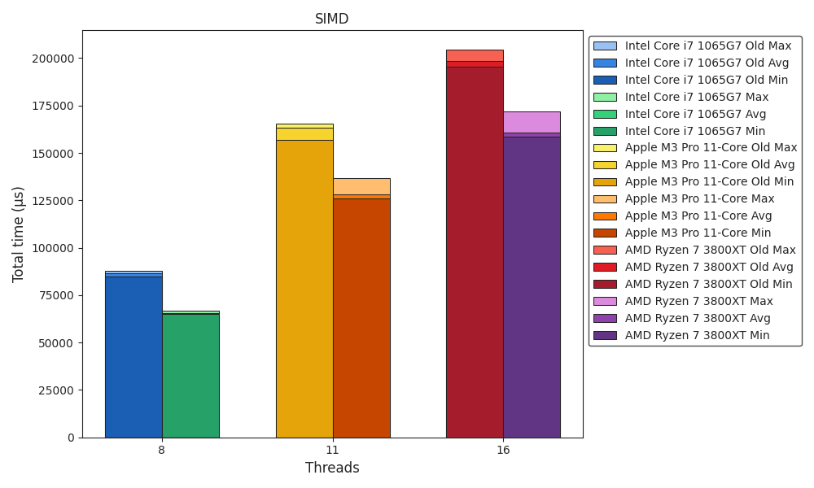
Benchmark
SIMD

Slide 15
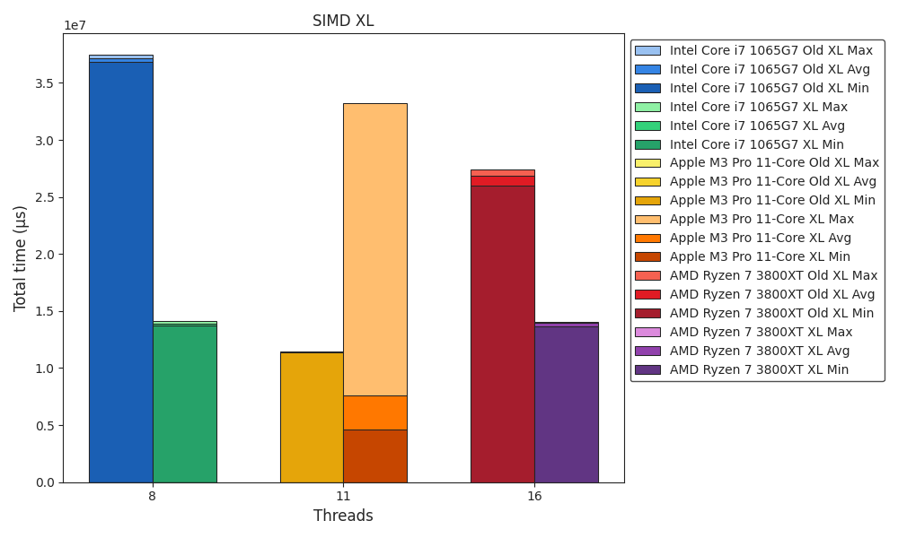
Benchmark
SIMD XL

Slide 16
Multithreading & SIMD
AMX (1 / 2)
Progress
Fixed void matmul_simd(mt_arg *mt);
Implemented void conv2d_simd(mt_arg *mt);
AMX Registers
X (or Y) Registers:
4 source registers for computations
Containing 64 floating-point values in total
Z Registers:
Serves as the accumulator or output registers
Holds a 64x64 floating-point matix
AMX Instructions
Defined in aarch64.h:
Implemented as macros for assembly instructions
Utilize bitmasks (bm) to define instruction behavior
Key instructions:
AMX_SET(); and AMX_CLR(); Frame an AMX instruction block
AMX_LDX(bm); or AMX_LDY(bm); Load values into the X or Y registers
AMX_STZ(bm); Stores values from the Z registers into memory
AMX_FMA32(bm);: Performs fused multiply add (z[j][i] += x[i] * y[j])

Slide 17
Multithreading & SIMD
AMX (2 / 2)
Example AMX Instruction
Extract of void matmul_simd(mt_arg *mt);
Power Consumption
Measured with powermetrics (average values)
uint64_t ldx = (uint64_t)&(*mt->a)->m[get_idx(mt->i, 0, (*mt->a)->y)];
ldx = ldx | 1ull << 60; // four registers
ldx = ldx | 1ull << 62; // multiple registers
uint64_t fma32 = 1ull << 63; // vector mode
uint64_t stz = (uint64_t)&z_reg;
// ...
for(int k = 0; k + CHUNK_SIZE - 1 < (*mt->a)->y; k += CHUNK_SIZE) {
size_t k_offset = k * sizeof(DATA_TYPE);
AMX_LDX(ldx + k_offset);
AMX_LDY(ldy + k_offset);
for(int i = 0; i < CHUNK_SIZE / LANE_SIZE; i++) {
size_t i_offset = LANE_SIZE * i * sizeof(DATA_TYPE);
AMX_FMA32(fma32 + i_offset + (i_offset << 10)); // x and y offset
}
}
AMX_STZ(stz);
AMX_CLR():
Benchmark | mW
Neon | 7331
AMX | 7778
Neon XL | 7340
AMX XL | 7218

Slide 18
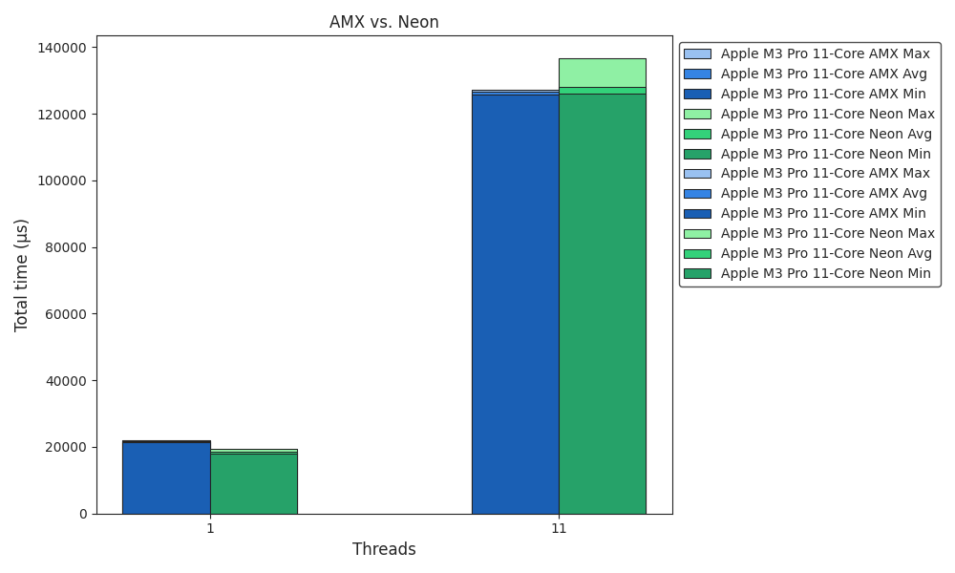
Benchmark
AMX vs. Neon

Slide 19
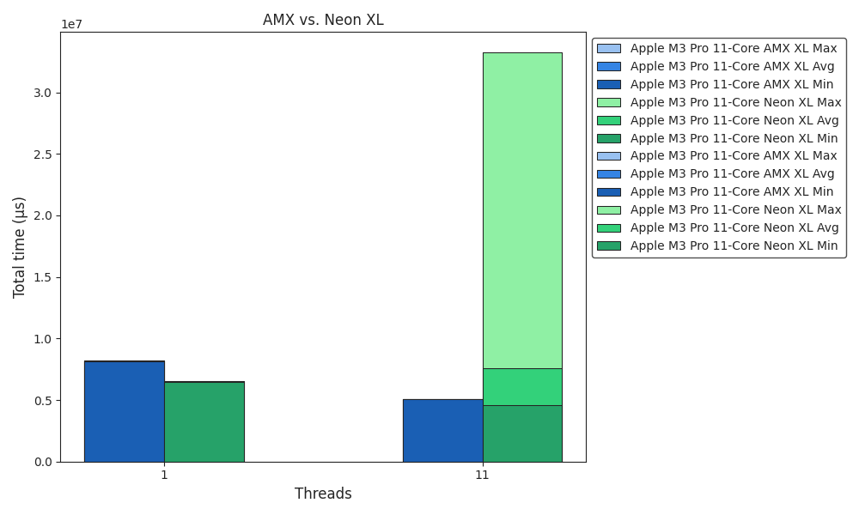
Benchmark
AMX vs. Neon XL

Slide 20
Quantization
Overview
Data Type Optimization
Change: float32 → int8
Benefit: Standard for AI/ML quantization, enabling greater efficiency with minimal accuracy loss
SIMD Integration
Change: Added support for int8 in AVX-512, AVX2, and Arm Neon
Benefit: Process even more elements in parallel, significantly boosting computation speed
Memory Reduction
Change: Model size reduced by ~10% (282.8MB → 253.7MB)
Benefit: Frees up memory on resource-limited devices
__attribute__((always_inline)) inline void matmul_simd(mt_arg *mt) {
#ifdef x86
#ifdef __AVX512F__
#ifdef INT
long CHUNK_SIZE = sizeof(__m256i) / sizeof(DATA_TYPE);
__m256i a, b;
__mmask32 m;
for(int k = 0; k < (*mt->a)->y; k += CHUNK_SIZE) {
m = (__mmask32)((1 << (((k + CHUNK_SIZE) <= (*mt->a)->y) ? CHUNK_SIZE : (*mt->a)->y - k)) - 1);
a = _mm256_maskz_loadu_epi8(m, &amp;(*mt->a)->m[get_idx(mt->i, k, (*mt->a)->y)]);
b = _mm256_maskz_loadu_epi8(m, &amp;(*mt->b)->m[get_idx(mt->j, k, (*mt->b)->y)]);
(*mt->c)->m[get_idx(mt->i, mt->j, (*mt->c)->y)] += _mm256_reduce_add_epi16(_mm256_mullo_epi16(_mm256_cvtepi8_epi16(_mm256_extractf128_si256(a, 0)), _mm256_cvtepi8_epi16(_mm256_extractf128_si256(b, 0))));
(*mt->c)->m[get_idx(mt->i, mt->j, (*mt->c)->y)] += _mm256_reduce_add_epi16(_mm256_mullo_epi16(_mm256_cvtepi8_epi16(_mm256_extractf128_si256(a, 1)), _mm256_cvtepi8_epi16(_mm256_extractf128_si256(b, 1))));
}
...
}

Slide 21
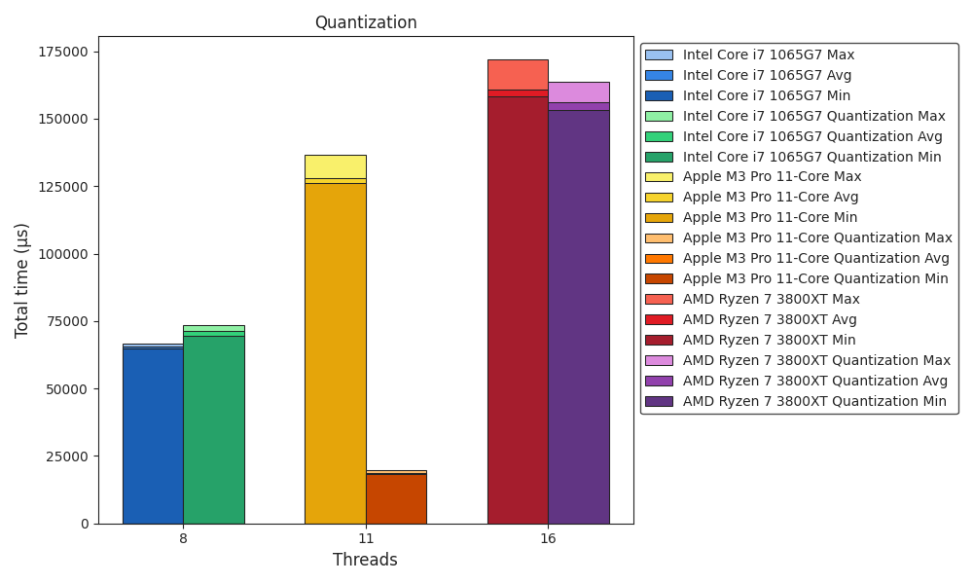
Benchmark
Quantization

Slide 22
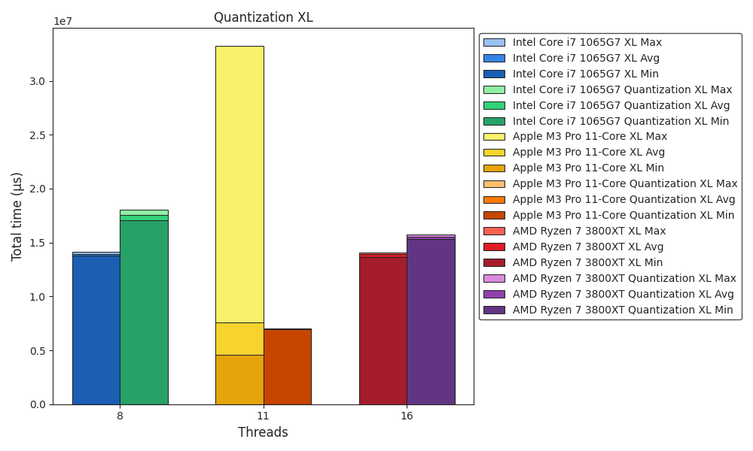
Benchmark
Quantization XL

Slide 23
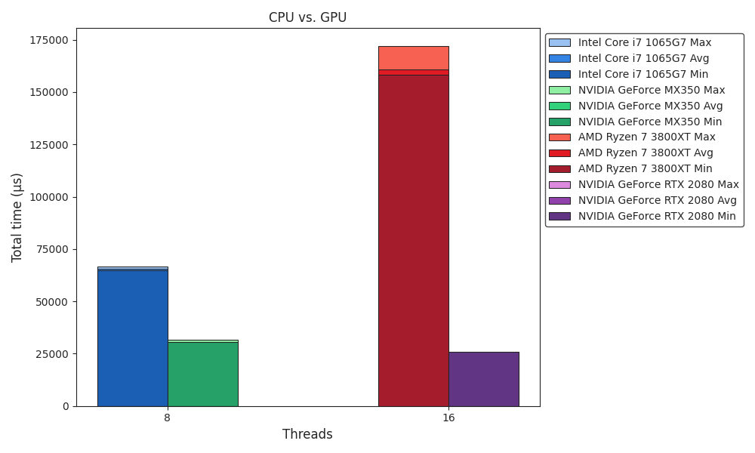
Benchmark
CPU vs. GPU

Slide 24
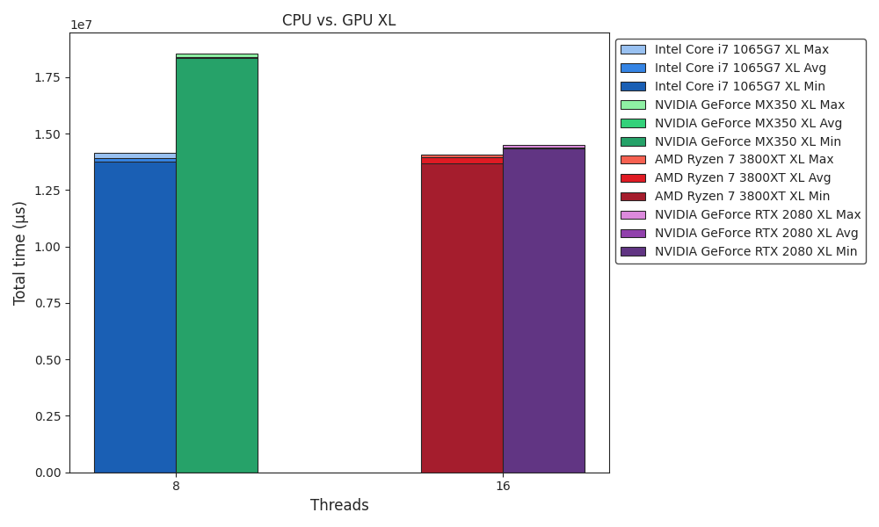
Benchmark
CPU vs. GPU XL

Slide 25
Outlook
Work In Progress
Framework ✅
ICPX vs. Clang ✅
CUDA Tuning ✅
Improve matmul performance
Multithreading ✅
Multithread images
OpenMP GPU offload target
SIMD ✅
Quantization 🚧
Apple AMX
Quantization layer

